Slide 1
Car Locator App
Fall 2010
VIP Smartphone Team
Ahmad, Din, Vinayak

Slide 2
Outline: Car Locator App
Development background
Progress and Obstacles
Results
Future work

Slide 3
Development background: Car Locator App
The application, when started, takes an image of the current location from Google Maps (at a certain resolution).
It then plots a course on that image (using GPS), as the user moves.
User clicks on a button when going back to the car and the app starts showing the current location in a different color so that he can differentiate between the “departure” path and the “return” path.
The app should include a turn-off notification or a standby feature.

Slide 4
Development background: Car Locator App
Start app
Extract image from GM and save starting location coordinates
Draw a “dot” periodically (0.1s? 0.2s?) at the current coordinates
Ask the user to/automatically shut down the app after saving the map after a certain time
Display saved image when app restarts and start updating current position periodically with a different color
On OK, delete saved picture
On arriving at destination, display an appropriate message
END

Slide 5
Development background: Car Locator App
Milestones
Get a UI ready for the app – 9/21/2010
Look up resources on utilizing GPS using Java – 9/28/2010
Write code to acquire an image for the current location off of Google Maps – 10/12/2010
Write code to mark current position on phone – 10/26/2010
Bugs and fancy work – 11/16/2010
Write report/finishing touches on app – 12/07/2010

Slide 6
Initial plans: Car Locator App
Feature
Method/Resource
Extract image from Google Maps
Obtaining coordinates periodically and saving coordinates
Draw dots on coordinates
Ask user to close the app after some time period
On arrival to destination, display message
Static Maps API
GPS location listener
Phone’s vibrator
Alert dialog popup

Slide 7
Progress and Obstacles: Car Locator App
Static Maps API
Less reliance on data usage
Used ImageView and initial GPS coordinates to obtain static map
Problem: static map is not able to zoom, pan and scroll
Solution: changed to using Google’s dynamic Maps API, allows for most features in Google Maps.

Slide 8
Progress and Obstacles: Car Locator App
MapActivity
Implemented on activity class to allow MapView that uses the Maps API
Problem: Force closing when changing from an Activity to a MapActivity
Solution: Uncertain. Code was implemented correctly, and it suddenly works out to be fine. Probably an SDK or Eclipse issue.

Slide 9
Progress and Obstacles: Car Locator App
MapView Overlays
Allows drawables(icons, lines etc.) to be placed on the map
Used previous and current coordinates to draw lines, initial and final coordinates to draw dots
Problem: Line connected between final and initial coordinates.
Solution: Added a variable that saved the previous point and only connected these points

Slide 10
Progress and Obstacles: Car Locator App
Options Menu
Allows for the use of hard menu button to display a number of other options/buttons.
Used to create a cleaner GUI.
Problem: Wanted to add more buttons in certain screens without creating clutter.
Solution: Implemented Options Menu in MapScreen.java and CarLocator.java.

Slide 11
Progress and Obstacles: Car Locator App
Location Listener
Listens for GPS antenna updates with specified parameters
Initially specified to listen for updates every 2 seconds
Problem: Battery and data consumption issue when user is not moving.
Solution: Changed specifications to listen for a set amount of distance.

Slide 12
Progress and Obstacles: Car Locator App
User personalization
Created Options.java to allow for user settings
Settings such as toggling satellite/map view, anti-aliasing, vibrator, timer display, and line thickness.
Problem: Line thickness is an integer function, not a boolean operation.
Solution: Implemented SeekBar for line thickness, ranges from 0 to 10. Boolean operations implemented using Checkbox.

Slide 13
Progress and Obstacles: Car Locator App
Chrono timer
Added timer to tell user the car parking duration
Helpful for parking garages and meters
Problem: If the phone reboots while timer is on, it will return a negative value since the timer refers to the system clock when the phone is turned on.
Solution: Show --:-- if the scenario happens. User needs to restart the app to enable the timer function.

Slide 14
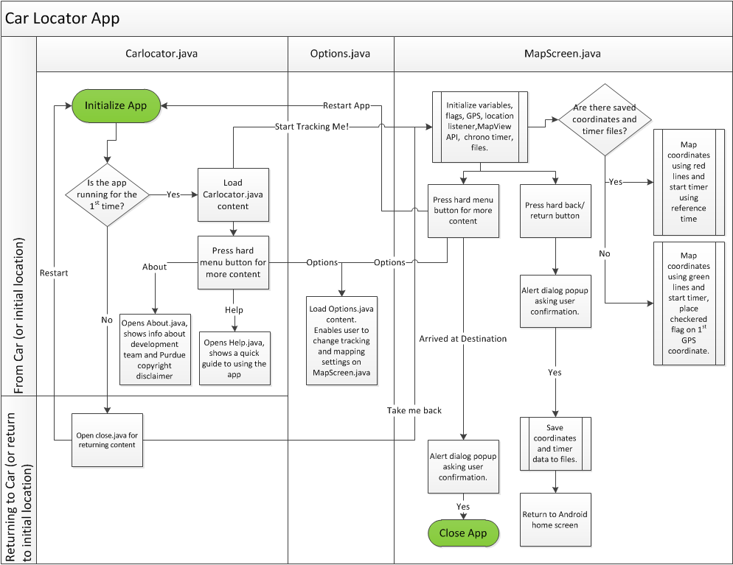
Results: Car Locator App

Slide 15
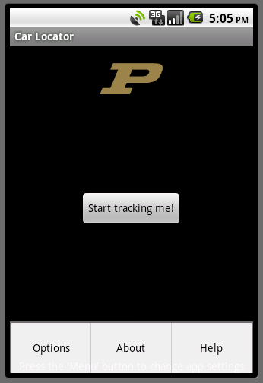
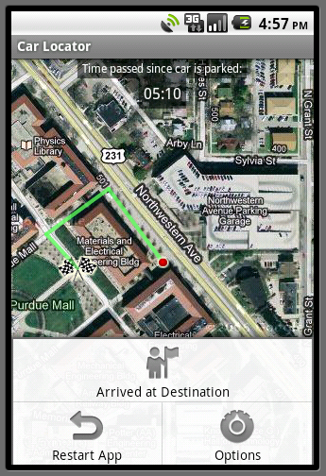
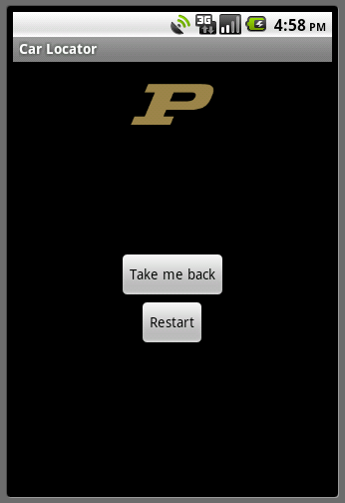
Results: Car Locator App

Slide 16
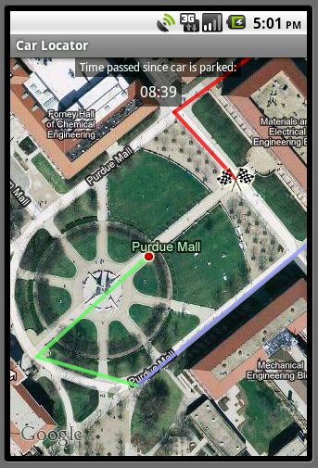
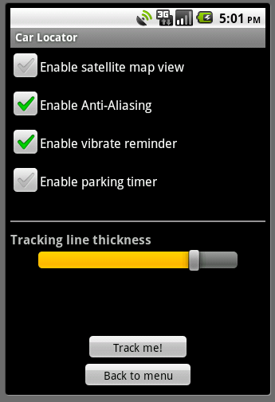
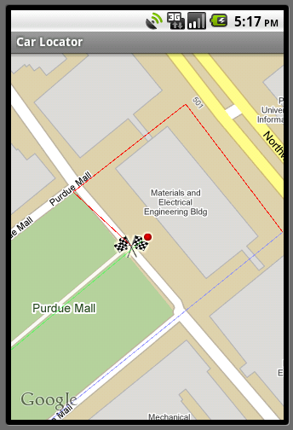
Results: Car Locator App

Slide 17
Deviation from initial plans: Car Locator App
Initial
Final
Static Maps API
Obtaining coordinates periodically
On arrival to destination notification
Hard-coded parameters
Dynamic Maps API
Obtaining coordinates after certain distance interval
On arrival button with alert dialog popup
Created Options.java to allow for some user settings

Slide 18
Future work: Car Locator App
Extensive testing on real world conditions to find issues.
Improving code for better performance
Find better implementation of certain functions, like the timer.
Implement new features from Android 2.3 launch (i.e. new Maps API features)

Slide 19
Questions & Feedbacks
We like feedbacks, especially positive ones, they are constructive and essential to improving ourselves.
Documented in the wiki.
https://engineering.purdue.edu/vipfor/wiki/index.php/Car_Locator

